Slide 1
KSDE Budget Workshop 2020-21
Kathy KO is my CEC contact and the LD Association would be a sub-affiliate of CEC. We also have a BD Association and an ID Association all sub-affiliates of CEC. This is not a KSDE issue as it is a voluntary membership.
Kathy KO is my CEC contact and the LD Association would be a sub-affiliate of CEC. We also have a BD Association and an ID Association all sub-affiliates of CEC. This is not a KSDE issue as it is a voluntary membership.
Dale M. Dennis, Deputy Commissioner
S. Craig Neuenswander, Director School Finance

Slide 2
Governor’s 2020-21 Allotments
Funded BASE foundation aid per pupil ($4,436 to $4,569)
Increased the amount of the State Foundation Aid payment delayed from June, 2021, to July, 2021
Funded supplemental general state aid law
Funded capital improvement state aid law
Funded capital outlay state aid law

Slide 3
Governor’s 2020-21 Allotments
Funded school KPERS law
Funded juvenile detention facilities
No change in special education state aid
Funded amount required for Mental Health Intervention Team Pilot Program

Slide 4
Governor’s 2020-21 Allotments
Did not fund Safe and Secure Schools State Aid Grants ($5 million)
Did not fund Juvenile Transitional Crisis Program ($0.3 million)
Did not fund the Career & Technical Education Transportation program ($1 million)

Slide 5
House Bill 2016 (COVID Response Bill)
State Finance Council manages Federal COVID relief funding.
Governor’s COVID measures are guidance only
Counties may set their own regulations
School closing by Governor must be approved by State Board of Education

Slide 6
General Fund Base Aid for Student Excellence (BASE) 2018-19 $4,165 2019-20 $4,436 2020-21 $4,569 2021-22 $4,706 2022-23 $4,846 2023-24 CPI

Slide 7
Supplemental General Fund Increases by 3-year average CPI
2018-19 $4,490
2019-20 $4,558
2020-21 $4,608

Slide 8
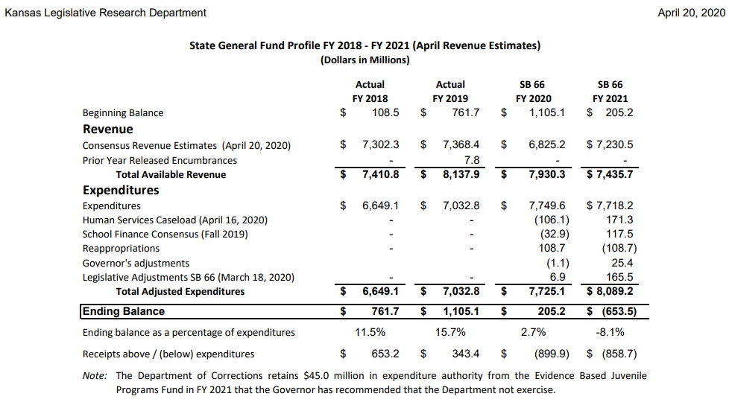

Slide 9
Assessed Valuation Gas and Oil appraisal set Jan. 1
Appraisal guide amended in March
First time in 34 years

Slide 10
CARES Act
Coronavirus Aid, Relief, and Economic Security ESSER
Elementary and Secondary School Emergency Relief
$76,076,155
Distributed on the Title I Formula
Deposit in Federal Funds
Revenue Line 4595 CARES Act

Slide 11
CARES Act - ESSER Funds shall only be used for:
Staff development
Any expense caused as a result of COVID-19 pandemic
Unique needs of low-income students
Homeless students
Needs of individual schools

Slide 12
CARES Act - ESSER
Students with disabilities
English as second language learners
Foster care youth
Coordination of preparedness and response of the school district
Mental health services

Slide 13
CARES Act - ESSER
Sanitation and cleaning supplies for the school district
Educational technology
Summer learning and after school programs
Other activities necessary to maintain the operation and continuity of services

Slide 14
SPECIAL EDUCATION EXCESS COST
HISTORY – (KSA 72-3422) Current law provides for 92% of excess cost.
2008-09 | $ 427,753,137 (92.0%)
2009-10 | $ 367,540,630 (88.7%) | Rec. ARRA--$ 56,517,000
2010-11 | $ 389,404,843 (92.0%) | Rec. ARRA--$ 54,454,000
2011-12 | $ 428,140,397 (88.4%)
2012-13 | $ 427,724,000 (82.8%)
2013-14 | $ 427,717,000 (80.1%)
2014-15 | $ 428,360,566 (80.8%)
2015-16 | $ 434,902,949 (80.0%)
2016-17 | $ 435,469,632 (79.6%)
2017-18 | $ 445,981,646 (78.5%)
2018-19 | $ 490,380,818 (81.4%
2019-20 2020-21 | $ 497,880,818 (75.3%) $ 505,380,818 (72.0%)

Slide 15
Special Education – Categorical Aid
Year Actual
2013-14 $27,900
2014-15 $27,520
2015-16 $27,955
2016-17 $27,750
2017-18 $28,010
2018-19 $30,085
2019-20 $29,800 (Estimate)
2020-21 $29,510 (Estimate)
2021-22 $29,210 (Estimate)
Notes:
Our business cards will stand out as innovative and memorable with a vertical or portrait orientation. Bonus it has a back side!
a portrait or vertical design. It’s also two-sided!
Another fundamental change you may notice (if not you will after I tell you) is that the main address for our agency has been simplified to the main desk in Suite 102. As all our mail is sorted in the print shop having everything labeled by a different team name and suite only made sense to us as we're used to it. It is less confusing and complex for those we serve.

Slide 16
CARES Act Special Education ESSER-Special Education funds may only be used to provide additional special education and related services that are necessary to respond to the COVID-19 interruption.
$8,030,231 = $565 per FTE Teacher
Deposit in Code 30, Special Education
Revenue Line 4595 CARES Act
Transfer to Interlocal/Coop

Slide 17
Bilingual Legislative Post Audit
Due January 15, 2021
Weighting based on:
* FTE Enrollment in approved program (0.395)
* Headcount (0.185)
All Bilingual expenditures must be made from bilingual fund

Slide 18
Cash Balances Legislative Post Audit
Due January 15, 2021
Recommendation for municipalities by Alvarez & Marsal is 15% of operating funds
Is the overall cash balance going up or down and what is your plan?

Slide 19
Cash Balances Operating cash balances, excluding:
supplemental general fund,
bond & interest,
capital outlay,
food service,
gifts and grants,
special reserve,
federal funds,
special assessments,
activity funds,
adult education funds, and
special education cooperatives.

Slide 20
Remote Learning Environment
(Not a virtual school)
Verification for Audit:
Must be enrolled 9/20
Assessed on same standards and competencies
Must have daily connection with a teacher
Maintain daily log of activities signed by student and parents, submitted to district

Slide 21
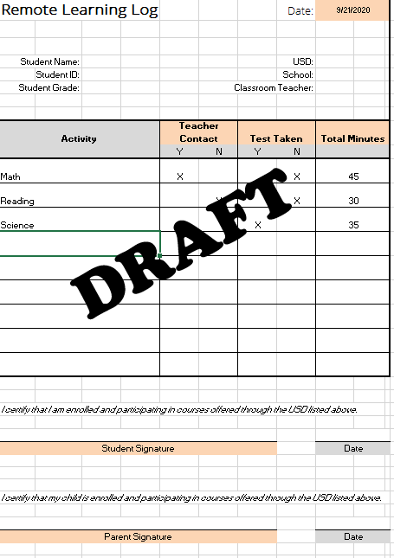

Slide 22
Food Service
Latest USDA Guidance
If school closes due to COVID-19 outbreak, students must be charged for meals based on their eligibility status.
(i.e. they are not all free meals like last spring.)

Slide 23
Confirmed Cases of COVID-19
(Monthly Survey)
How many students are you aware of who have newly contracted COVID-19 this month?
How many staff members are you aware of who have newly contracted COVID-19 this month?

Slide 24
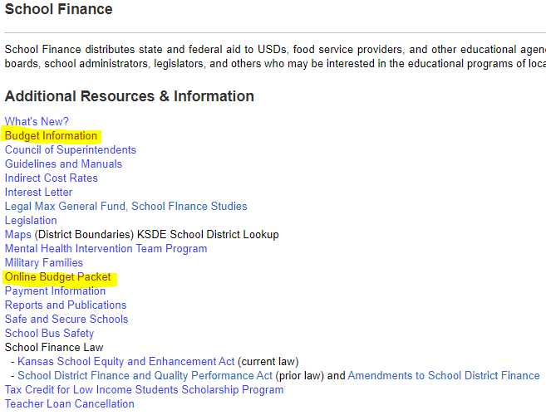

Slide 25
Budget Dates
Board approves publication – August 8*
Latest publication of budget – August 15
Adoption of budget – August 25
Enrollment count date – September 20
Preliminary general fund estimates from state (legal max) – November 15
Notes:
Fact Sheet

